Slide 1
Introduction to Android Development
Jake Grzegorski
jakegrzegorski@gmail.com
@jakegrzegorski

Slide 2
Agenda
Introduction to the Android Platform
Setting up the Development Environment
Anatomy of an Android Project in Eclipse
Sample Address Book Application
UI
Activities
Pop ups
SQLite
Deploying Application

Slide 3
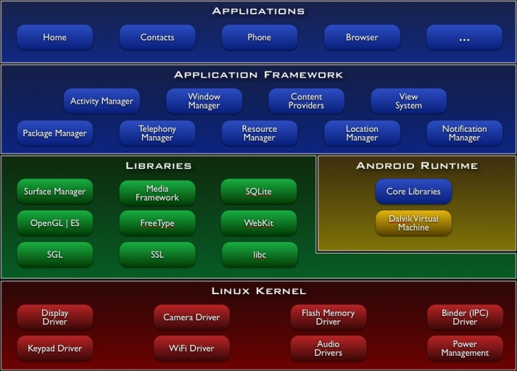
Android Architecture
Android Platform Layers
Applications
Application Framework
Native Libraries
Linux Kernel
Applications and application framework are written in Java and run on Dalvik virtual machine.
Native libraries are written in C or C++.
Linux Kernal handles hardware driver, networking, file system.

Slide 4
Setting Up the Development Environment
Required Software
Eclipse
Android SDK
ADT for Eclipse

Slide 5
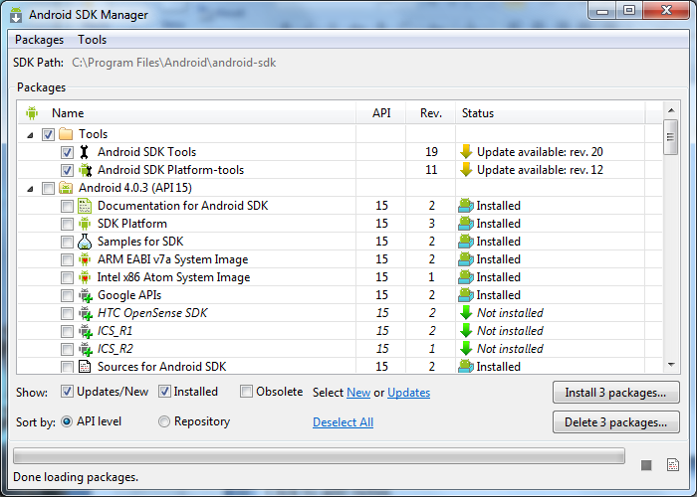
Android SDK
Download the SDK Manager from http://developer.android.com/sdk/index.html
Download the SDKs for each version of Android you plan to develop on.
Most older phones still use version 2.3.3.
Many tablets will use version 3.0. Version 3.0 was specifically designed for tablets.
Newer phones and tablets are starting to use version 4.0.3 and up.

Slide 6
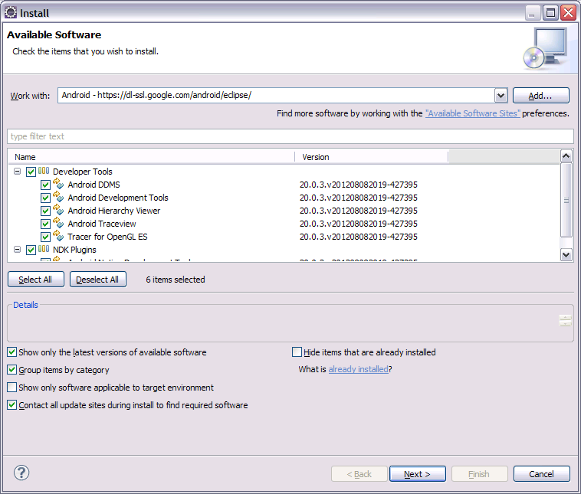
Setting up Android Developer Tools in Eclipse
In Eclipse go to Help -> Install New Software
Click Add to add the URL for the Android Developer Tools –/ Android - https://dl-ssl.google.com/android/eclipse/
Select the tools to install. Click Next.
Agree to the licensing terms.
Install

Slide 7
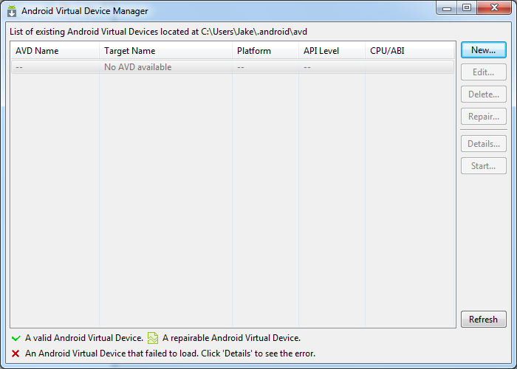
Creating an Android Emulator
After installing Android
Development Tools
(ADT), you will be able to
use the Android Virtual
Device Manager to
create an Android
Emulator. There will
be a button on the
Eclipse menu to launch it.
After opening the
Virtual Device Manager,
click New to create a
new emulator.

Slide 8
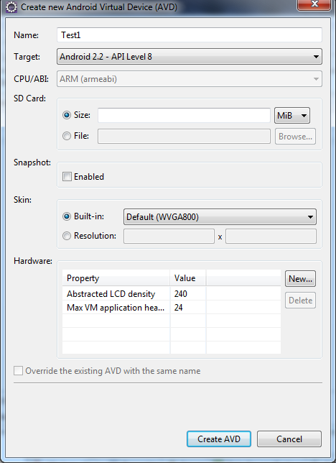
Creating an Android Emulator
There are several options that can be selected when
creating an emulator.
Name: Name for the emulator.
Target: The version/API level of the Android Platform that the emulator will use.
SD Card: The amount of storage that the emulator will have available.
Skin: The screen resolution of the emulator.
More information about hardware option can be
found on Google’s Android Developer site.

Slide 9
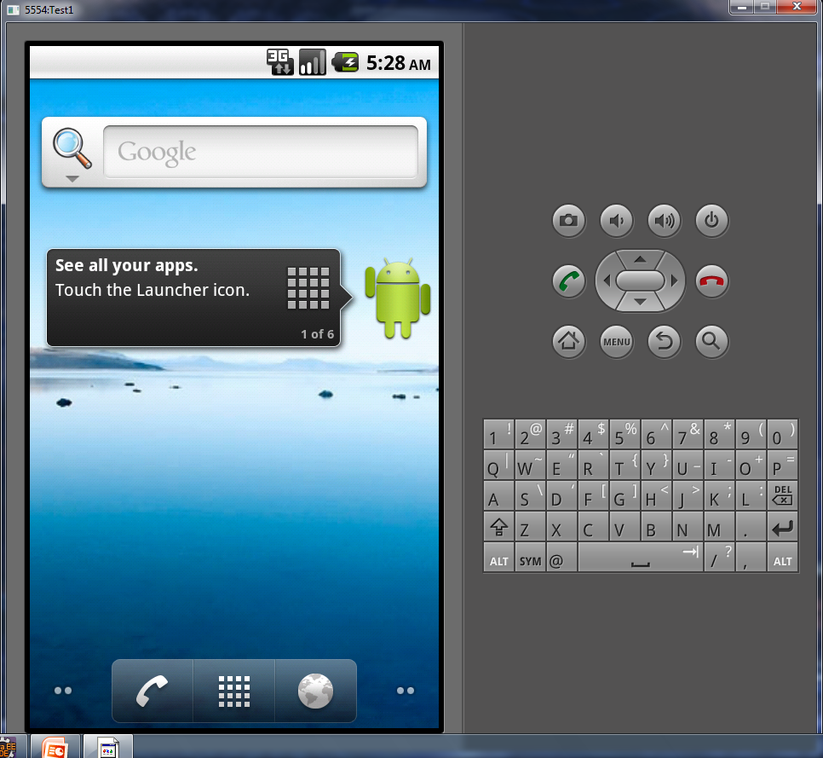
Creating an Android Emulator
The Android emulator will have a small number of basic Android applications.
Settings can be changed in the Android Virtual Device Manager.
Additional settings can be set in the DDMS.

Slide 10
Anatomy of an Android Project
Folder | Purpose
scr | Java source code.
gen | Files generated by the Android framework. In general not edited by developers.
bin | Compiled package for deployment.
res | Resources used by the application.
res/drawable-xxxx | Contains images for use in the application. Each folder contains images at different screen densities.
res/layout | Contains XML layouts for the UI.
res/values | Contains stings to use in application. Used for internationalization.
AndroidManifest.xml | Sets application properties, declares activities.

Slide 11
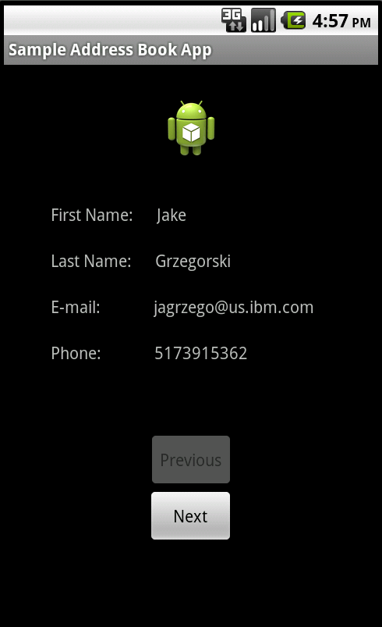
Sample Address Book Application
The purpose of Sample Address Book Application is to explore the basic functionality of the Android platform without getting into detailed business logic.
Android Functionality Used:
Android Activities
Click events for buttons.
Retrieving and validating text input.
Using application resources (UI layout, images, menus).
Reading and writing data from a SQLite database.

Slide 12
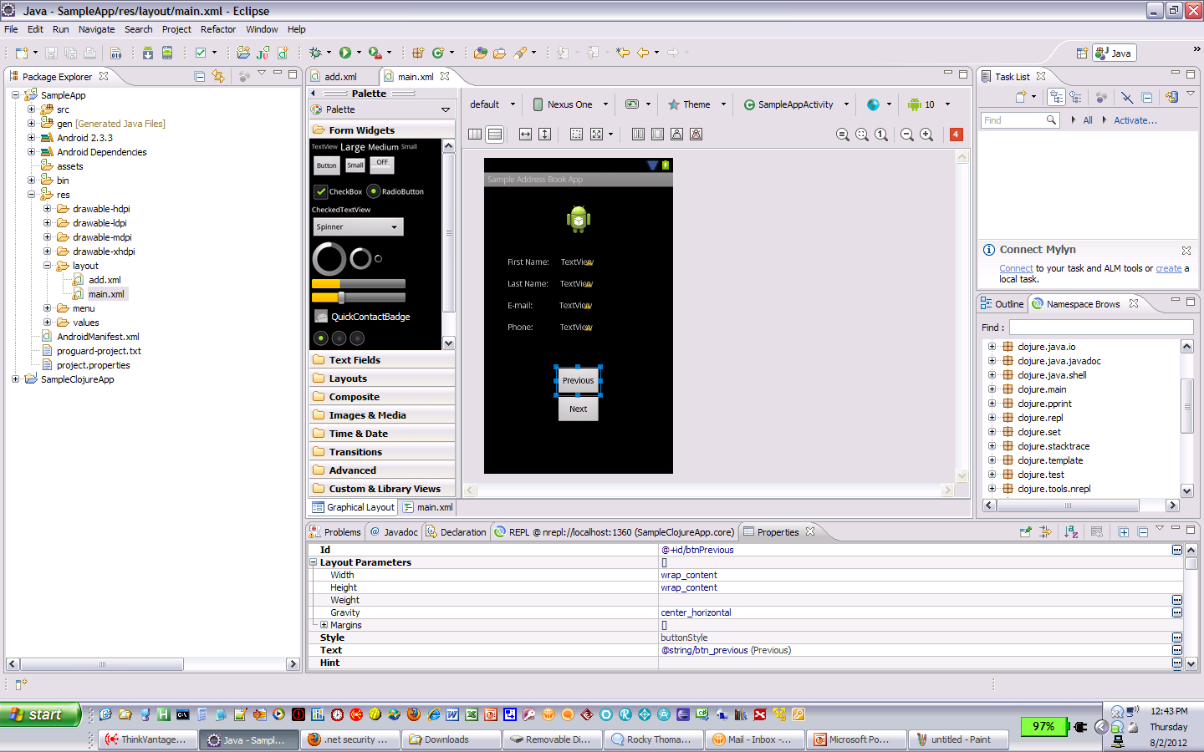
Sample Application UI
The ADT plug-in for Eclipse includes a graphical designer for UI layout.
The UI Layout is saved as XML. The XML can also be edited directly.
Properties of the UI widgets can be set through the Properties tab in Eclipse.
The functionality of UI widgets can be implemented in Android Activities.

Slide 13
Activities
Activities are the main building blocks of an Android Application.
Typically, each UI screen is associated with one activity.
Unlike most Java applications, there is no Main() method. There is a main activity set up in the Android manifest XML file that will be started when the application is launched.
When adding an Activity to the project, you must add the Activity to the Android manifest XML file.
The Activity class have several methods to override, including:
onCreate
onCreateOptionsMenu
onOptionsItemSelected
onActivityResult
Data can be passed between activities.

Slide 14
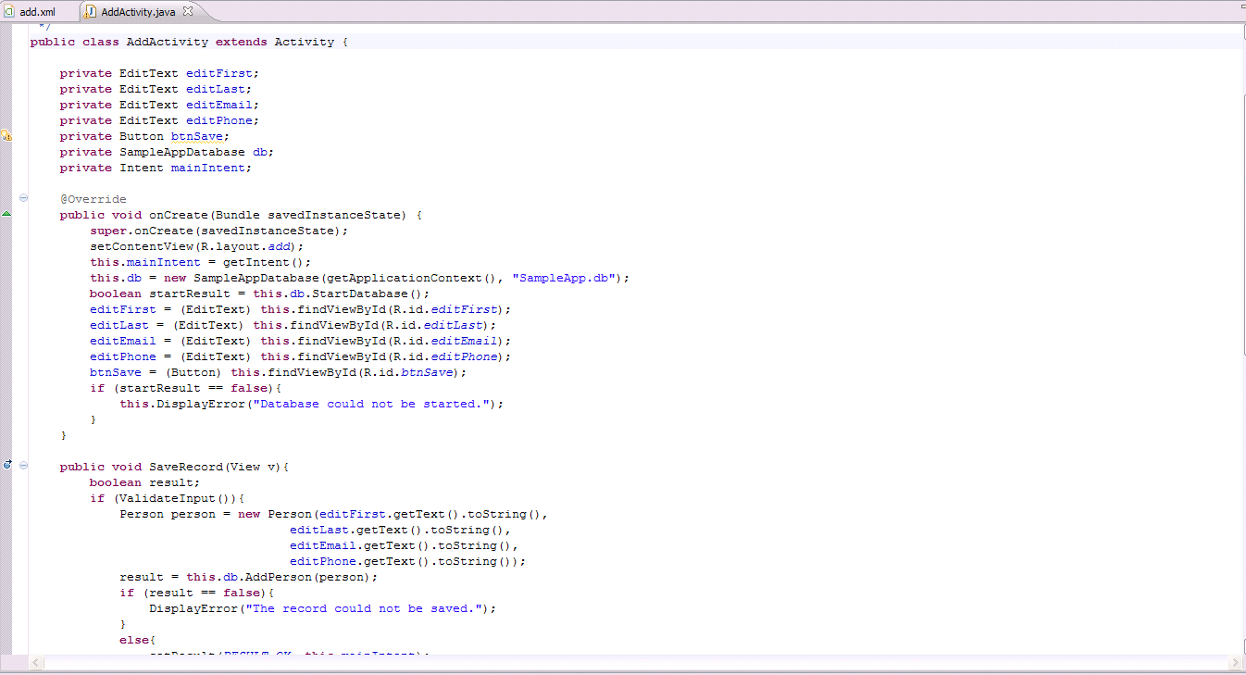
Sample App Main Activity
The Main Activity displays records from a SQLite database.
A previous and next buttons allow for navigation through the records.

Slide 15
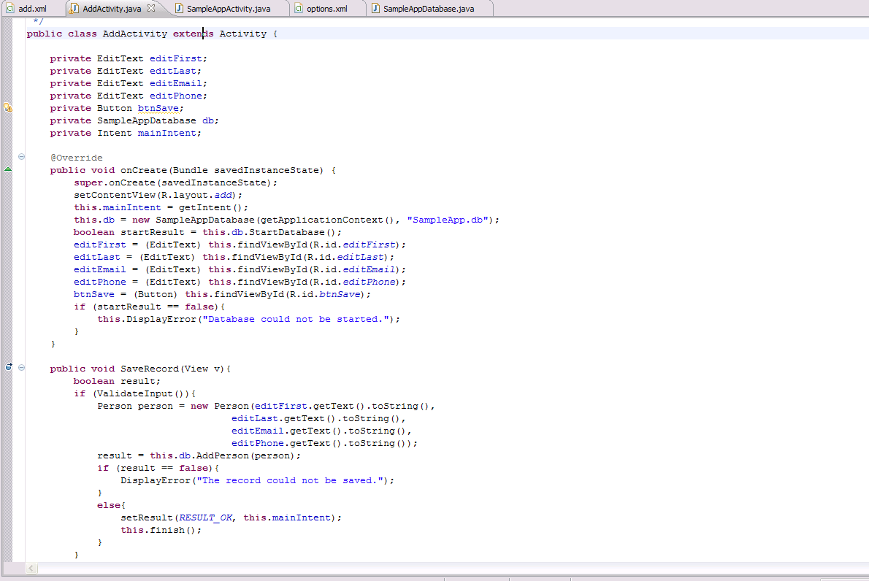
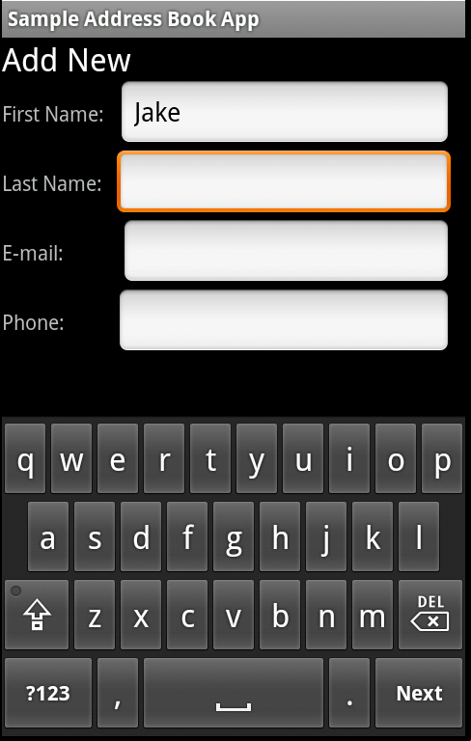
Sample App Add Activity
The Add activity allows the user to add a new person to the application.
When the user clicks Save, the entries will be validated for format.

Slide 16
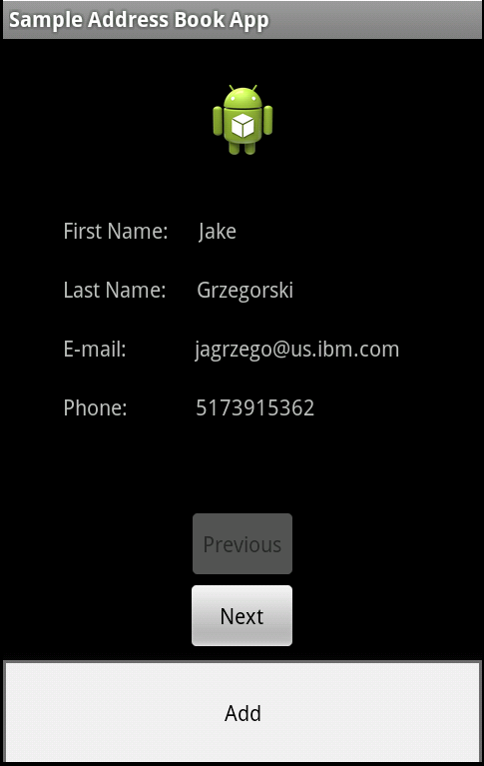

Creating a Menu
Although the dedicated menu button has been depreciated in Android 3, older versions of Android will require that the menu button is handled.
The menu is created using XML. It is stored in the res folder under menu.
The onCreateOptionsMenu method handles creating the menu when the menu button is pressed.
The onOptionsItemSelected handles the selection of a menu item.
Android 3 and up uses the Action bar to display menu items. It is created in the same way as the menu.

Slide 17
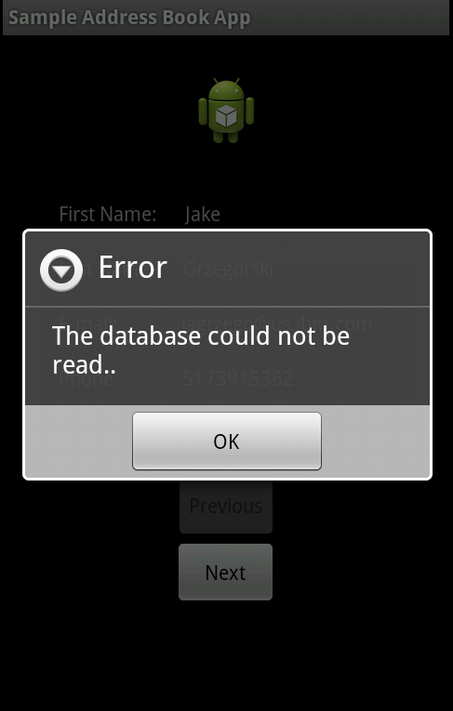
Dialog Boxes
Alert dialog boxes are set up using the AlertDialog.Builder class.
The builder is used set the message, title, and the event handlers for the buttons.
An alert dialog can display up to 3 buttons.
Set the alert dialog to use the properties set by the AlertDialog.Builder by using the create() method. Ex. AlertDialog alert = builder.create();
Display the dialog by using the .show() method.
Android includes other built-in dialogs including ProgressDialog, DatePickerDialog, and TimePickerDialog.

Slide 18
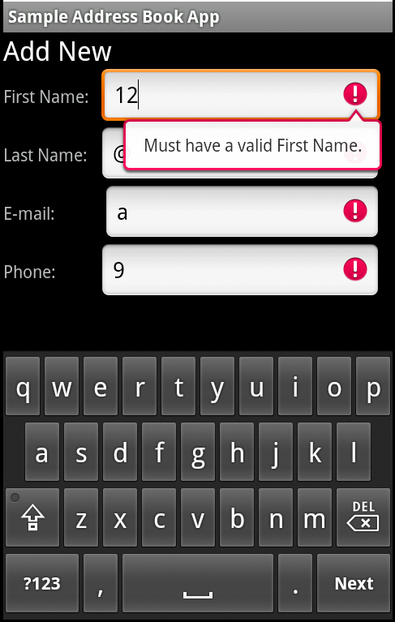
Validation
EditText controls can be set to display certain keyboards when the user wants to enter data.
An EditText control set to accept phone numbers will display a keyboard with only numbers.
Actual validation functions need to be created by the developer.
An error message can be set on an EditText control using the setError property.

Slide 19
SQLite
SQLite is a file-based database that Android application can use to store data locally.
The Android platform has several classes and methods for manipulating SQLite databases.
A database can be opened or created using the Android Application Context. The Context.openOrCreateDatabase() method is used for this.
SQL statements can be executed against a SQLite database using the .rawQuery() method.
The Cursor object handles the results of a query.

Slide 20
Resources
Useful Links for Android Development
Environment Setup - http://developer.android.com/sdk/installing/index.html
Reference - http://developer.android.com/reference/packages.html
Activities - http://developer.android.com/guide/components/activities.html
Menus - http://developer.android.com/guide/topics/ui/menus.html
Dialogs - http://developer.android.com/guide/topics/ui/dialogs.html
SQLite - http://developer.android.com/guide/topics/data/data-storage.html#db
SQLite Reference - http://developer.android.com/reference/android/database/sqlite/SQLiteDatabase.html
EditText Validation - http://blog.donnfelker.com/2011/11/23/android-validation-with-edittext/
Deploying App to Phone - http://developer.android.com/tools/device.html
Publishing an App - http://developer.android.com/tools/publishing/publishing_overview.html

Slide 21
Troubleshooting
Problem 1: Can’t load Android ADT through Eclipse.
Solution: Download ADT as .zip file from the Android site. Install from archive in Eclipse.
Problem 2: Timeout error when trying to load application into the emulator.
Solution: 1. Install latest updates for the SDK. 2. In the Preferences in Eclipse, raise the time out for DDMS.

